Slide 1
Qualys Competitors | Tenable and InsightVM Pilots 2025
Presented by: Tyler Hiovich, Austin Berg, and Aidan Thomas

Slide 2



Executive Summary
Tenable and Rapid7’s InsightVM are direct competitors of Qualys
Focus: Configuration Compliance, Scan Accuracy, Compatibility
Both Tenable and InsightVM are missing several mission-critical features
As potential Qualys replacements, both products were evaluated:
Tenable: Accurate IOS vuln detections; other features fall short of expectations
InsightVM: Inherent design trade-offs increase workflow complexity and cost
Notes:
On note 3, there is considerable friction between MetLife’s existing technology stack and InsightVM implementation and use, which is a major factor in our recommendation to avoid

Slide 3
Tenable
3

Slide 4


Tenable | Configuration Compliance
All modifications to custom benchmarks must be done offline in a text editor, then uploaded to the console for testing & validation *
Does not support configuration validation within the tool *
Does not have a severity rating system for configurations
MetLife’s Config Compliance program relies on severity ratings, without this feature we would no longer be able to provide guidance on prioritization to our stakeholders
Tenable requires manual rescans for updated scan results (Qualys is automated)
On feature enhancement roadmap for Q4 2025*

Slide 5

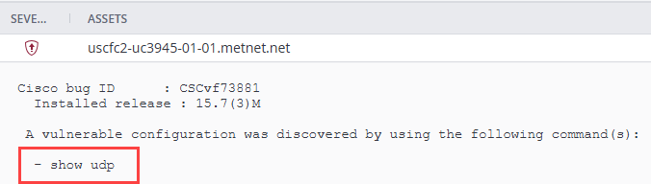
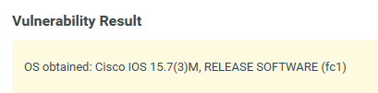
Tenable | Network Device Vuln Detections – Routers & Switches
Tenable vulnerability detections are more accurate than Qualys due to being able to run configuration commands
Tenable does not provide the command output
Router
Tenable: 11 vulns (All accurate)
Qualys: 34 vulns (Unknown Accuracy)
Switch
Tenable: 5 vulns (All accurate)
Qualys: 16 vulns (Unknown Accuracy)
Tenable (CVE-2018-0151)
Qualys (CVE-2018-0151)
11.6k False positive overrides in Kenna (and growing)

Slide 6
Tenable | Agent Comparison – Operational
Tenable
Does not support automated scanning for VM or Config Compliance
Does not support AIX, Solaris, or RHEL 6 (Approx. 3.3k hosts)
Different installer for each version of RHEL (i.e. RHEL 7,8,9 all have their own installer)
For Linux there is a mandatory wait time of 5 minutes required for agent activation
Does not support on-demand scanning
Qualys
Offers automated scanning for VM & Config Compliance
Supports all OS that MetLife uses
Consolidates install/mass deployments to a single method for each major OS (i.e. all RHEL uses one package, all Windows uses one package)
Supports immediate activation for Linux agents
Supports on-demand scanning for individual hosts or groups of hosts

Slide 7
Tenable | Cost
Tenable One
Premier offering including asset criticality scoring, asset inventory, etc. We would want to choose this if MetLife is considering doing a full end-to-end replacement
8000 License 1yr – $65,000 x 3 = $195,000
5000 License 1yr – $52,000 x 3 = $156,000
Tenable TVM
Barebones solution with minimal features and support
8000 License 1yr – $62,728 x 3 = $188,184
5000 License 1yr – $49,768 x 3 = $149,304
Notes:
Out of the box pricing:
5,000 licenses: $10.40 per license
8,000 licenses: $8.125 per license
Price Reduction for Volume of 225K licenses is estimated at 900K for 1 year and 2.2M for 3 years

Slide 8
InsightVM
8

Slide 9

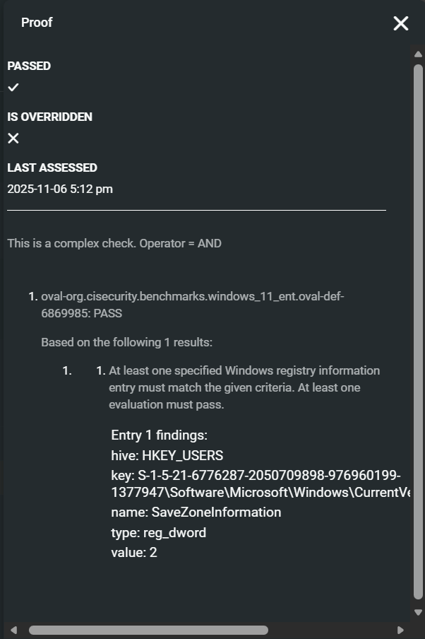
InsightVM | Configuration Compliance
Customization for benchmarks in the GUI is comparable to Qualys
Remote Configuration Scans can be scheduled; but Agents deliver config data every 12 hours*
Supports configuration validation within the tool**
Does not have severity rating system for configurations
MetLife’s Config Compliance program relies heavily on severity ratings to prioritize critical configuration issues
*Agents do not support on-demand vulnerability or config compliance scans
**Bulk viewing the validation details—i.e., “Proof”—is only available via API (absent in GUI exports)
Notes:
The GUI is notably smoother than Qualys’s, but lacks robustness in terms of reporting features, prioritization, and asset grouping (more on that when we discuss tagging logic)

Slide 10
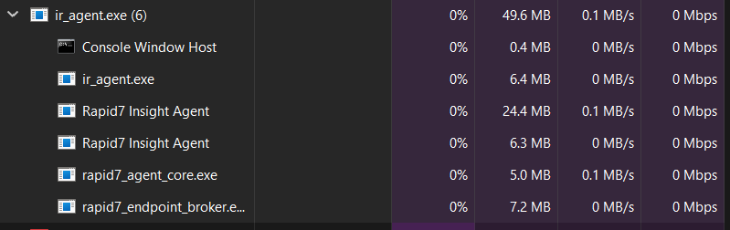
InsightVM | Agent Comparison (vs. QCA)
Feature | InsightVM | Qualys
Windows Support | ✔️ | ✔️
Linux Support | ✔️ | ✔️
MacOS Support | ✔️ | ✔️
AIX, Solaris, BSD | ❌ | ✔️
Legacy OS Support | ✔️* | ✔️
Insight Agent Strengths:
Support for prominent Operating Systems
Easy installation
Insight Agent Weaknesses:
More restrictive OS support
No On-Demand Scan Capabilities
Resource intensive by comparison
Less architecture support
Only x86-64
ARM (limited)
*Legacy Operating System is limited requiring agent versions to be downgraded for compatibility
Notes:
On Cons, Point 4: Qualys is robust in comparison--supports IBM zSystems, PowerPC, SPARC, ARM64, Intel x86/x64

Slide 11
InsightVM | Requirements
Rapid7’s cloud architecture restricts outbound connections to CyberArk
Security Consoles must be on-prem
Integration relies on CyberArk AIM (CCP is not supported)
A dedicated Security Console is required for each Trust Boundary (~10)
For 225K assets, each Security Console’s server will need:
12 Cores, 64GB RAM, and 2TB of storage*
For on-prem deployment, MetLife will also need to procure:
Infrastructure
Licenses**
Budget for any related incremental costs
*These resource quantities are estimates, based off MetLife’s footprint
**Both Windows and RHEL servers are supported for the software
Notes:
Rapid7’s cloud architecture restricts outbound connections to CyberArk
Security Consoles must be on-prem
Integration relies on AIM (CCP is not supported)
Each trust boundary, JV network, and in isolated environment will need its own dedicated Security Console
For 225K assets, each Security Console’s server will need:
12 Cores, 64GB RAM, and 2TB of storage*
For on-prem deployment, MetLife will also need to procure:
Infrastructure meeting Security Console requirements
CyberArk AIM licenses per Security Console
Additional server and VMware/vSphere licenses**
Budget for any related incremental costs

Slide 12
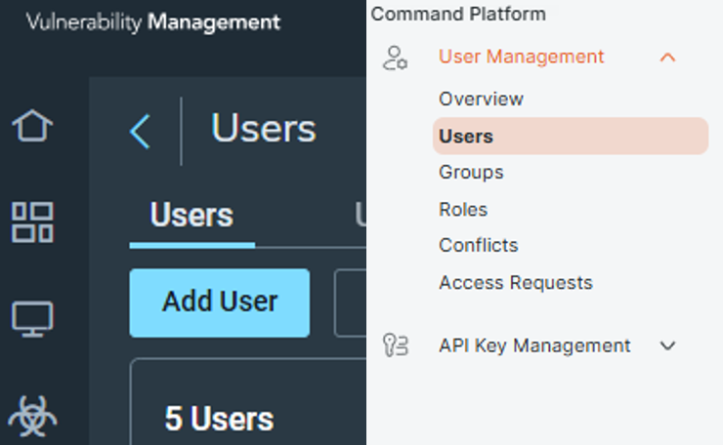
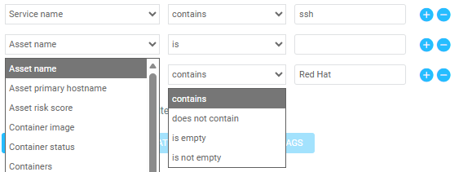
InsightVM | Features and Functionality
Tagging
Easy to use in the GUI
Logic is inadequate
Minimal API flexibility
Platform User Experience
Far from seamless
Redundancies in workflows
Multiple areas to manage
Common Use Cases
Limited software reporting
Service-to-port attribution
Notes:
For Tagging, every instance where we tag via a Groovy scriptlet will need to be re-engineered
For Platform User Experience,
Subpoint 1 – Certain administration tasks need to be completed on the Console while some need to be done on the Platform
Subpoint 2 – To assess our full footprint, we would need to sign into each Security Console separately. This means the steps we take in Qualys for threat assessments would need to be repeated in InsightVM for each Console. Multiple areas to manage users (users need to be added on the cloud platform and in each individual security console)
Subpoint 3 – Each security console's server will need it's own certificate, firewall rules, capacity planning, etc.

Slide 13
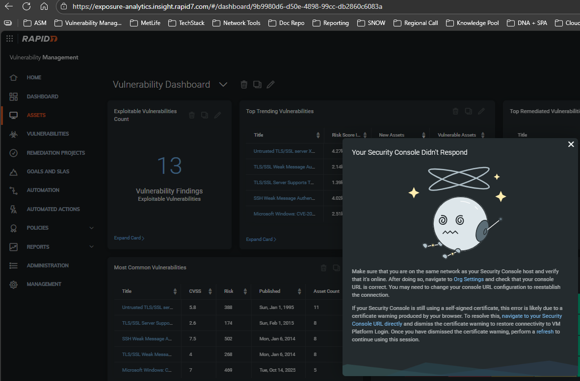
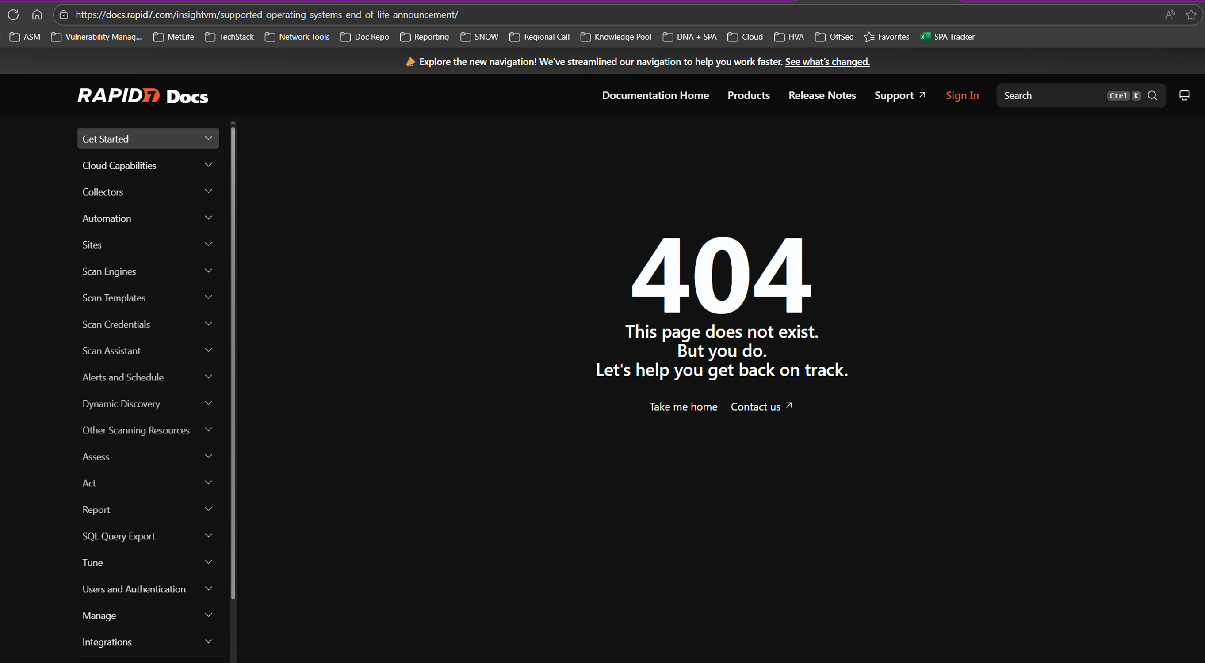
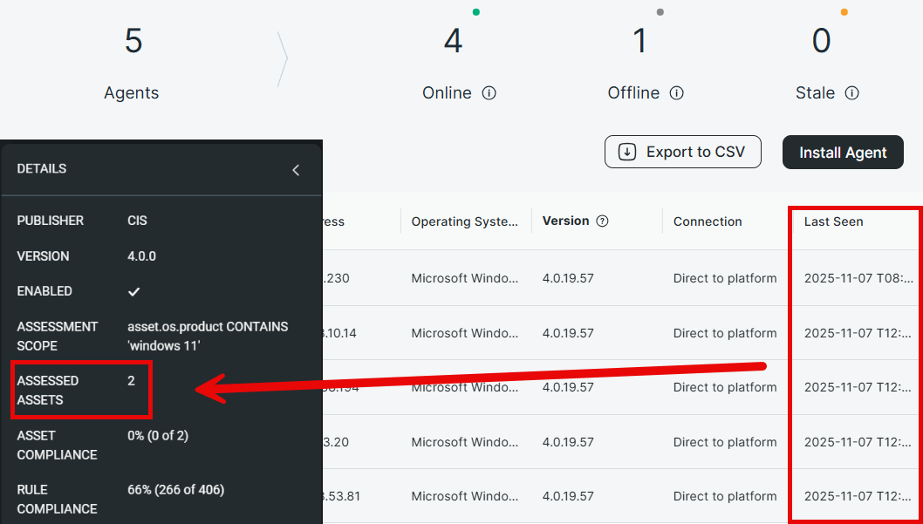
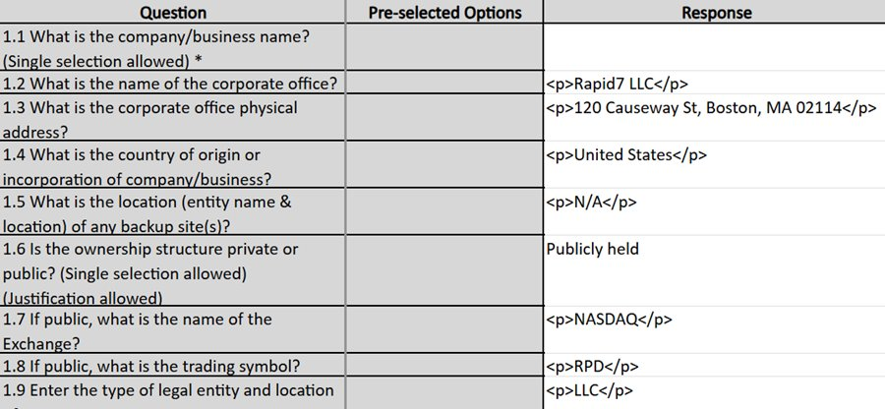
InsightVM | Quality Concerns
Poorly maintained collaterals, articles, and documentation
Artifacts show incomplete rebranding from Nexpose to InsightVM
(Default admin = nxadmin).
Console and platform have several bugs:
Inoperable export buttons
Error banners hiding GUI options
Agents not providing policy compliance data

Slide 14
InsightVM | Cost
Platform Licensing: $651,315 per year
Technical Account Management: $220,500 per year
Deployment & Custom Integration Support: $67,500 (one-time cost)
Rapid7’s Architecture constraints require additional investment for integration:
Cost | 1-Year | 3-Year
TAM + Platform | $871,815 | $741,042
Deployment Support | $67,500 | $67,500
Total | $939,315* | $2,290,626
*In total, the 3-year quote offers an incentive of ~$392K
Prerequisite | Cost
Server (RHEL/Windows) Licensing | $8,000
CyberArk AIM Licenses | $10,000
VMware / vSphere | $18,000
(R/S)ISC Hosting Hardware | $163,371
Product Service and Support | TBD
1-year Price Impact: +$199,371 3-year Price Impact: +$578,113
Notes:
The total for 3 consecutive years of the 1-year quote rate is ~$392K more than the 3-year quote total
For #3, this is the estimated cost of Rapid7’s support for integration (project planning, consultation, testing/troubleshooting, etc.)

Slide 15
Conclusion
15

Slide 16

*The prices quoted by Rapid7 (outlined in red) lose their advantage due to the costs associated with on-prem hosting
Notes:
For Tenable
Price Reduction for Volume of 225K licenses is estimated at 900K for 1 year and 2.2M for 3 years

Slide 17
Final Verdict
Qualys remains MetLife’s best option for end-to-end Vulnerability Management
Tenable
Value found in reduced False Positive rates, approximated at ~$78K, will be used as leverage to drive product improvements with Qualys
InsightVM
A fast and flexible GUI is the only competitive edge, but the overall UX is degraded as a result of integration restrictions
17
Notes:
~10hrs a week are spent between the teams that have to create the false positive tickets and our team that has to process them.
Creating tickets involves having to manually log into every single device individually, running the necessary commands to check config for respective vuln, take screenshots, put that into a word doc, create ticket in SNOW, then send to PA for review, then PA team has to process (this is what cumulatively takes ~10hrs a week) and happens basically every week or every other week.
It’s worth noting that this would in no way save us money with Qualys, as we are well beyond our allotted asset count as it is. So pulling 5k off the Qualys contract wouldn’t do anything because we’re already over our limit as it is

Slide 18
Appendix 1: Tenable
18

Slide 19
Threat Intel & Vuln Signatures
Tenable is generally quicker at producing new Vuln Signatures than Qualys
Tenable - 218,410 total Vuln Signatures
Qualys - 217,377 total Vuln Signatures
Both tools offer a dedicated Threat Intel module that provides event timelines, severity ratings, hosts impacted, etc.
Qualys is slightly more detailed in their vulnerability summaries by providing examples of the actual exploits
CVE-2025-4427/4428 (Ivanti EPMM CISA KEV)
Tenable VulnSig publish date: May 12
Qualys VulnSig publish date: May 20
CVE-2024-49112 (LDAP Sentinel Critical)
Tenable VulnSig publish date: Dec 09
Qualys VulnSig publish date: Dec 11
CVE-2025-4664 (Chrome CISA KEV)
Tenable VulnSig publish date: May 17
Qualys VulnSig publish date: May 19

Slide 20
MS Edge False Positive Detections
Qualys had a long-standing issue with providing false-positive detections for MS Edge, which had a significant downstream impact on Kenna scores
MetLife leverages the ‘Extended Support’ model (we get every other major version) but the security fixes are still applied to older versions of MS Edge
MetLife had to work with Qualys to call out this detection logic flaw for it to be evergreened and prevent FPs
Tenable is not aware of this issue, and during the Pilot was flagging hosts for MS Edge vulns that technically are not applicable (i.e. we’d have to also help Tenable resolve this like we did for Qualys all over again)
>500k
At minimum, more than 500k MS Edge vulnerabilities would be reintroduced into Kenna due to the flawed detection logic by Tenable

Slide 21
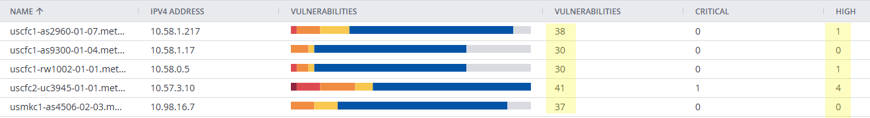
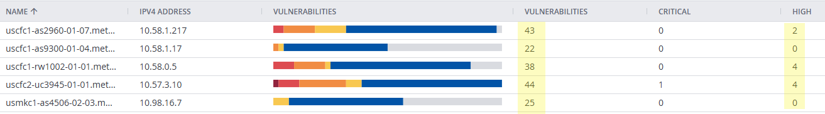
Network Device Vuln Detections – Routers & Switches Cont.
Paranoid Mode
Qualys equivalent to ‘Potential’
When enabled, identified vulns that Qualys never found (all confirmed accurate)
Paranoid Mode - Disabled
Paranoid Mode – Enabled (12 Additional vulns identified)
Notes:
Referencing one Router as example, Tenable found three vulns that Qualys never even flagged for

Slide 22
IAM
Tenable
Supports the ability to handle user provisioning & permissions through SAML
Allows User Impersonation
Control API access by IP address
Qualys
Does not support user provisioning & permissions within SAML
Requires test accounts be created to validate different permissions
Does not offer controls of API with IP address

Slide 23
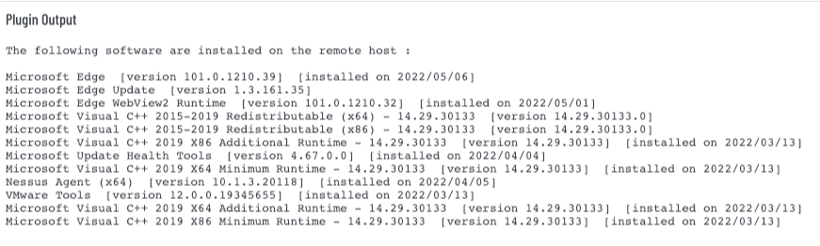
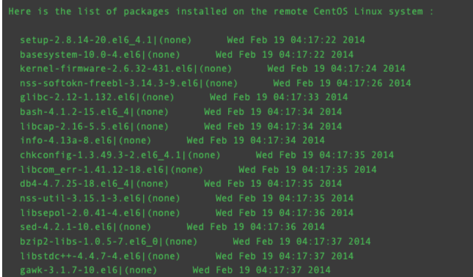
Installed Software
MetLife relies heavily on being able to view installed software/applications for further analysis of potential vulnerability exposure
Data must manually be exported to Excel to view installed applications directly from the scan results
Does not provide file path information
Windows 11 Workstation
Qualys – 170 unique applications found
Tenable – 108 unique applications found

Slide 24
General Comparisons
Use-Case | Tenable | Qualys
Creates system generated tags OOTB
User-friendly GUI navigation
Viewing scan output for vulns
Overhead for operational support
Total # vulnerability detections
Authentication credential management
Time to release new vulnerability detections
SSO/API User Provisioning & Permissions
Notes:
For authentication cred management, the reason why Qualys is superior is because you link the vault to Qualys one time and then build the auth records off that. In Tenable you have to add the vault details each time for every auth record

Slide 25
Appendix 2: InsightVM
25

Slide 26
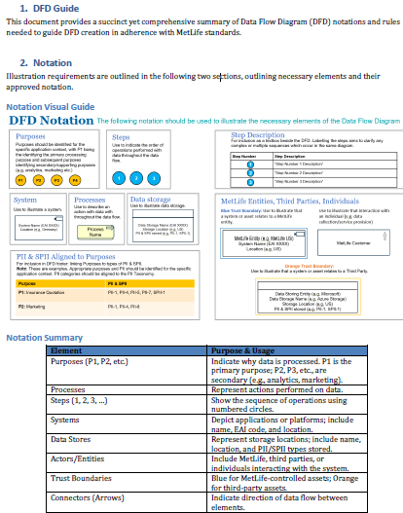
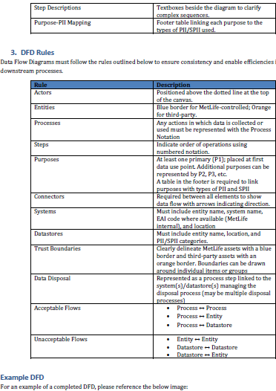
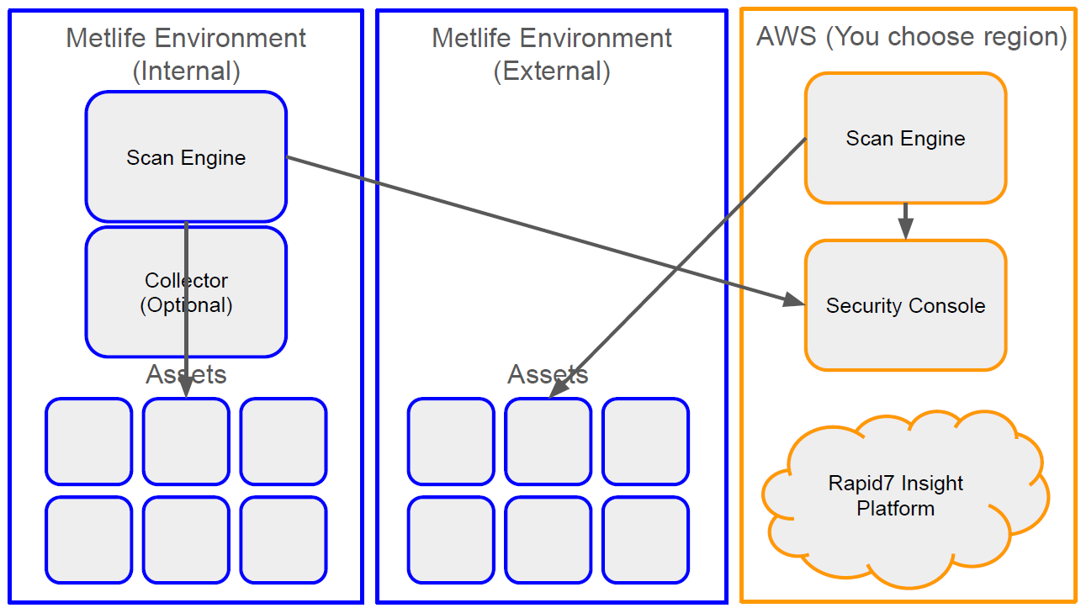
Data Flow Diagram
Expectation set with meticulously crafted guidance
Rapid7’s Submission

